Slide 1

Fake news detection:
A hybrid CNN-RNN based deep learning approach
SRAVANI NIHARIKA GARAPATI (16328843),
NIKHILA CHIRUMAMILLA(16323180),
SAIRAM CHAGANT(16327655),
SHRAVANI NALLA(12576204)

Slide 2

WHAT is FAKE NEWS ??
Intentionally deceptive content presented under the guise of legitimate journalism is a worldwide information accuracy and integrity problem that affects opinion forming, decision making is FAKE NEWS.
Spread through Facebook, Twitter, Media Platforms like TV, Radio
Deep learning Technique to detect fake news is the hybrid neural network model which is a combination of convolutional neural networks and recurrent neural networks is required to classify between fake news and legitimate news,

Slide 3
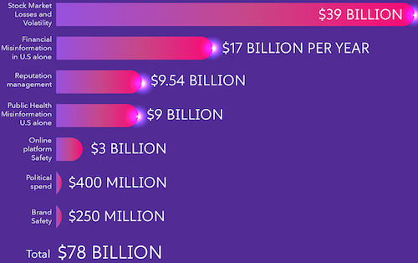
HOW MUCH DOES FAKE NEWS COST???
Annual Global Cost
Fake news is one of the greatest threats to commerce, journalism and democracy all over the world, with huge collateral damages
An economic study by Tel Aviv, Israel-based cybersecurity firm CHEQ and the University of Baltimore have revealed that fake news is costing the global economy $78 billion each year.
A US $130 billion loss in the stock market was the direct result of a fake new report that US president Barak Obama got injured in an explosion

Slide 4
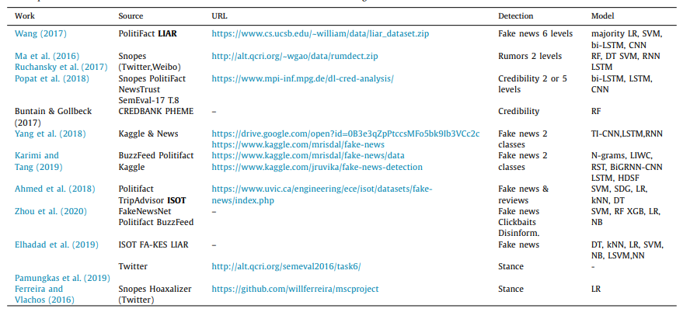
PREVIOUS TECHNIQUES AND DATASETS FOR FAKE NEWS DETECTion:

Slide 5
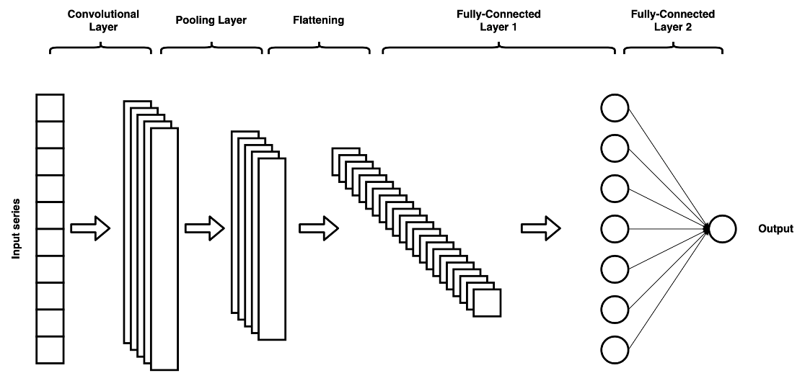
Convolutional Neural networks
A class of neural networks that specializes in processing data that has a grid-like topology
Steps involves: Convolution, Max pooling, Activation, Flattening
For the text data, Convolution deals with one dimensional arrays representing word vectors.

Slide 6
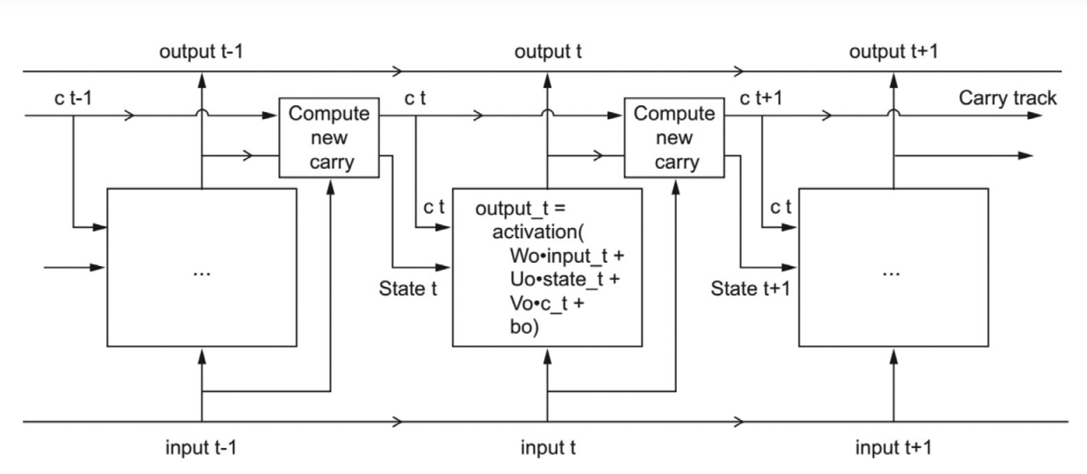
Recurrent NEURAL Network(RNN)
A sequential processing of the data for learning by its ability to retain a memory of what came before the current sequence being processed.
In this case many news articles can be considered for learning relative to each other instead of separately learning each news article.
LSTM (Long Short Term Memory) a typer of RNN has units which include a 'memory cell' that can maintain information in memory for long periods of time

Slide 7
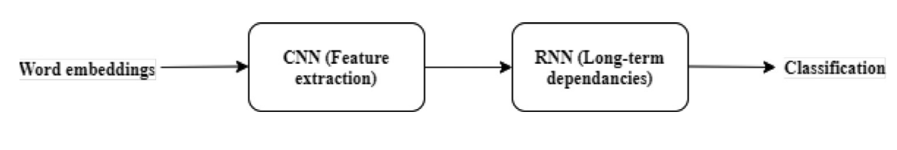
HYBRID CNN – RNN Model :
CNN to extract local features and of the LSTM to learn long-term dependencies.
Ability to capture both local and sequential characteristics of input data.
RNN can learn temporal and context feature from text, capture long-term dependencies between text entities and important features, which are detected using the ability of CNN in handling spatial relations.
Limitations:
difficulty in finding the optimal hyperparameters for each problem and dataset, the requirement for big training datasets, and the lack of interpretability

Slide 8
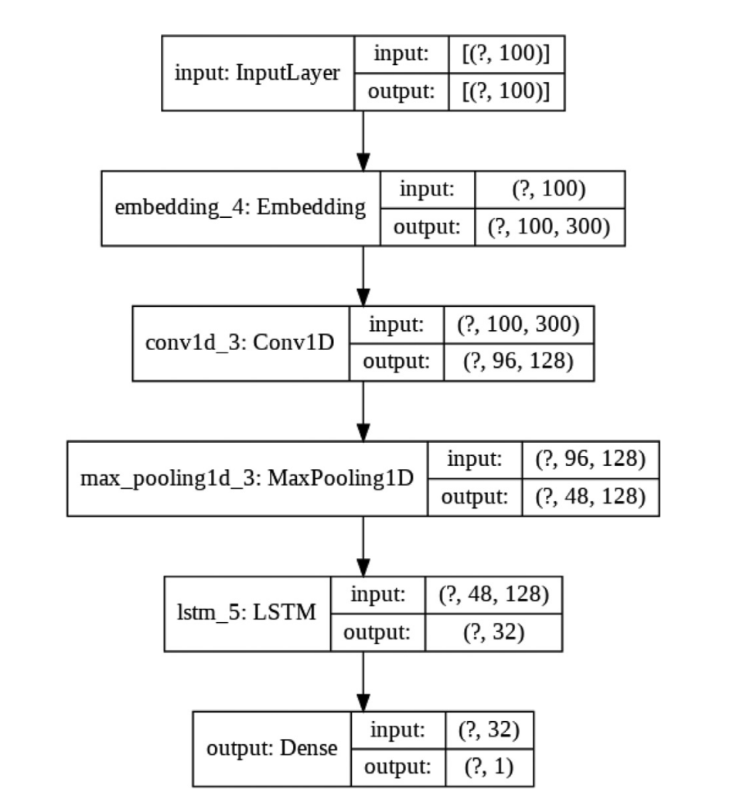
HYBRID CNN-RNN model :
Embedding Layer: Pre-trained word embeddings are utilized providing the prepared embedding matrix and the model is trained by feeding in the training data.
Convolution Layer: Extraction of local features(Relu Activation Function).
MaxPooling Layer: Down-sample the feature vectors without reducing accuracy.
LSTM Layer: Outputs the longterm dependent features of the input feature maps, while retaining a memory(Linear Activation Function).
Dense Layer: Shrinks the output space dimension to 1, which corresponds to the classification label (i.e., fake or not fake)(Sigmoid Activation Function).

Slide 9
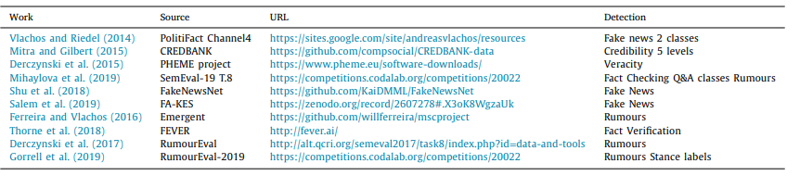
Data SET:
Among the above datasets FA-KES and ISOT Dataset is used for Fake news detection using hybrid model and other models for accuracy comparison.
Each dataset is split into training and testing subsets(80-20% split)

Slide 10
ABOUT FA-KES and ISOT:
FA-KES Dataset
The FA-KES5 dataset consists of 804 news articles on the Syrian war.
For each article, the headline, date, location and news sources are also provided in addition to the full body of text.
A class label with values ‘0’ for fake news and ‘1’ for real news is also available.
Small Dataset
ISOT Dataset
The ISOT dataset consists of 45,000 news articles, almost equally distributed to the true and fake categories.
The true articles were collected from the Reuters website, and the fake ones from various sources flagged as fake sources by Wikipedia7 and from Politifact. The datasets comprises the full body of each article, the title, date and topic.
Large Dataset

Slide 11
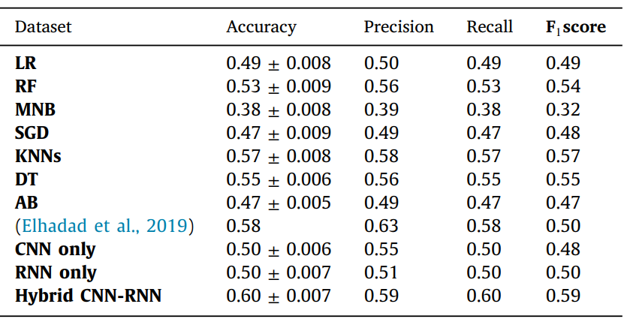
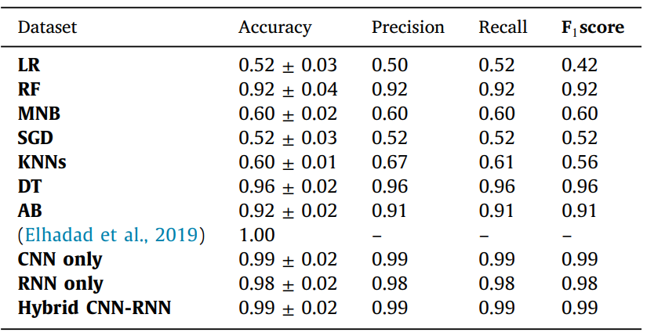
Results of all models on the FA-Kes and ISOt DATASETs:
FA-KES Dataset
ISOT Dataset

Slide 12
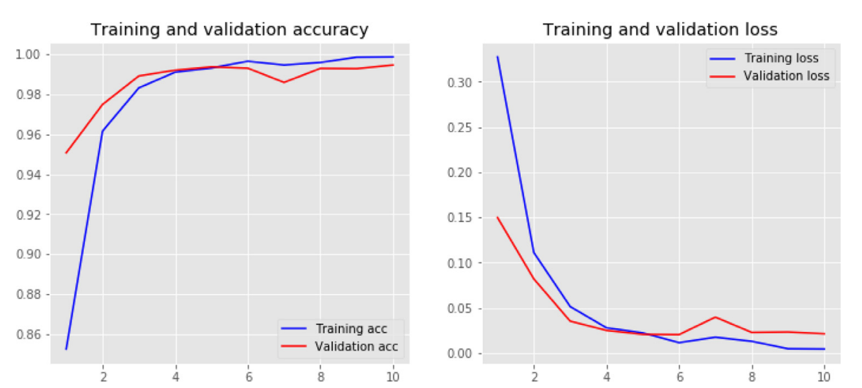
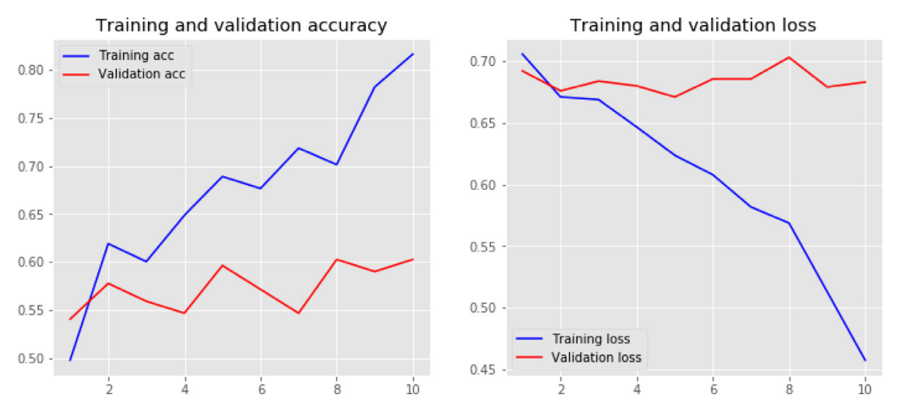
training and validation accuracy and loss graphs:
ISOT Dataset
FA-KES Dataset

Slide 13
TRAINING and VALIDATION LOSS:
FA-KES
The validation loss plot suggests an over-fitting of the model, since the loss fluctuates greatly with an increasing trend.
The cross-dataset validation results show poor generalization, since despite the very large corpus used for training, and the near 1.0 accuracy of the model on training, it performs poorly on another fake news dataset using the exact same structure.
Probably adding an internal drop-out layer could improve the ability of the model to generalize, and this will be further examined in the next work in the field.
The training and validation accuracy do not have a smooth increase.
ISOT
The proposed model performed very well for this data set
The training and testing accuracy increases with the epochs and similarly, the respective loss values decrease, which indicates that the model learns to classify the articles better.

Slide 14
CONCLUSION:
Overall, none of the supervised classification methods performs better than the proposed hybrid CNN-RNN model(un-supervised classification Method), though the variation in the accuracy is quite minimum.
There is a huge variation of accuracies in different datasets among the methods.
The discovery of new insights on the nature of fake news may lead to more efficient and accurate models.

Slide 15
References:
https://www.sciencedirect.com/science/article/pii/S2667096820300070
https://zenodo.org/record/2607278#.X3oK8WgzaUk.
https://www.uvic.ca/engineering/ece/isot/datasets/fake-news/index.php.
https://www.forbes.com/sites/kenrapoza/2017/02/26/can-fake-news-impact-the-stock-market.
https://en.wikipedia.org/wiki/List_of_fake_news_websites.
https://dl.acm.org/doi/10.1145/3217804.3217917

Slide 16
THANK YOU !!!
Any Questions??

